Slide 1

WHY I MADE
Reforged
A daily habit with God's Word
Boaz Briddick
Notes:
Open with the honest struggle. See script section 1 (0:00-1:00).

Slide 2
It wasn’t a
knowledge problem.
PSALM 1:2–3
“His delight is in the law of the Lord, and on his law he meditates day and night. He is like a tree planted by streams of water.”
It was a habit problem.
I knew Psalm 1. I could tell you why Scripture mattered. I just wasn’t living it — and the tools that helped me build every other habit had nothing to do with my Bible reading.
— ESV
Notes:
Name the deeper struggle. Script section 2 (1:00-2:15).

Slide 3
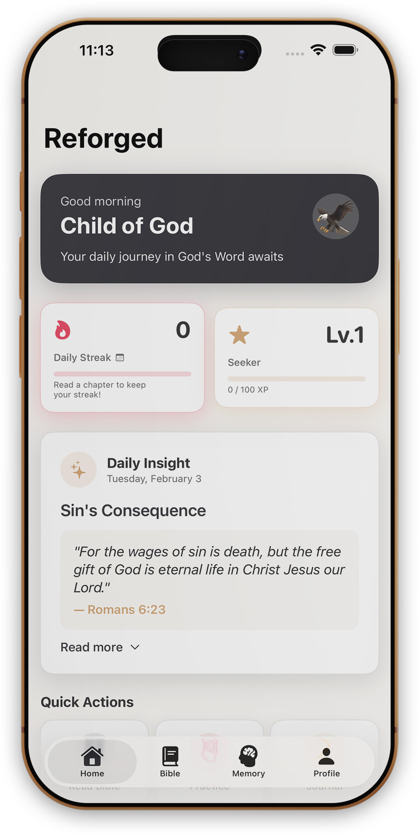
So I started building.
Not a company. Not a business plan. Just something for me — a way to actually keep a reading habit, and a way to memorize Scripture that didn’t rely on willpower.
That became Reforged.
Notes:
The turning point. Script section 3 (2:15-3:15).

Slide 4
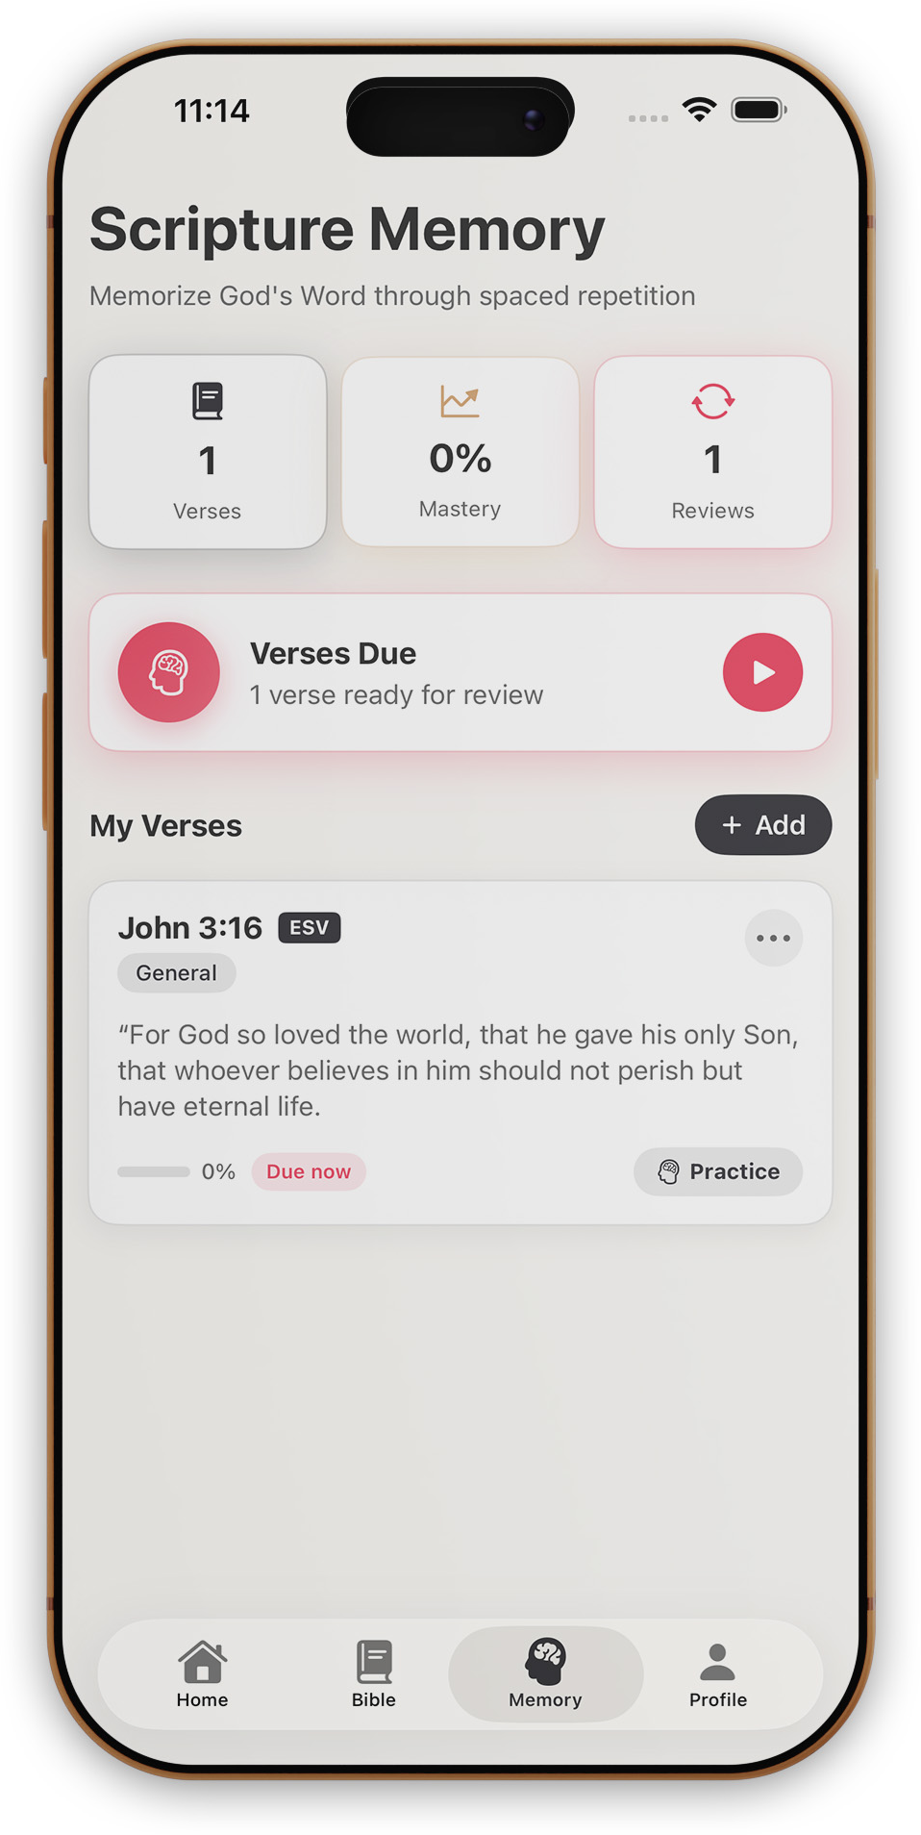
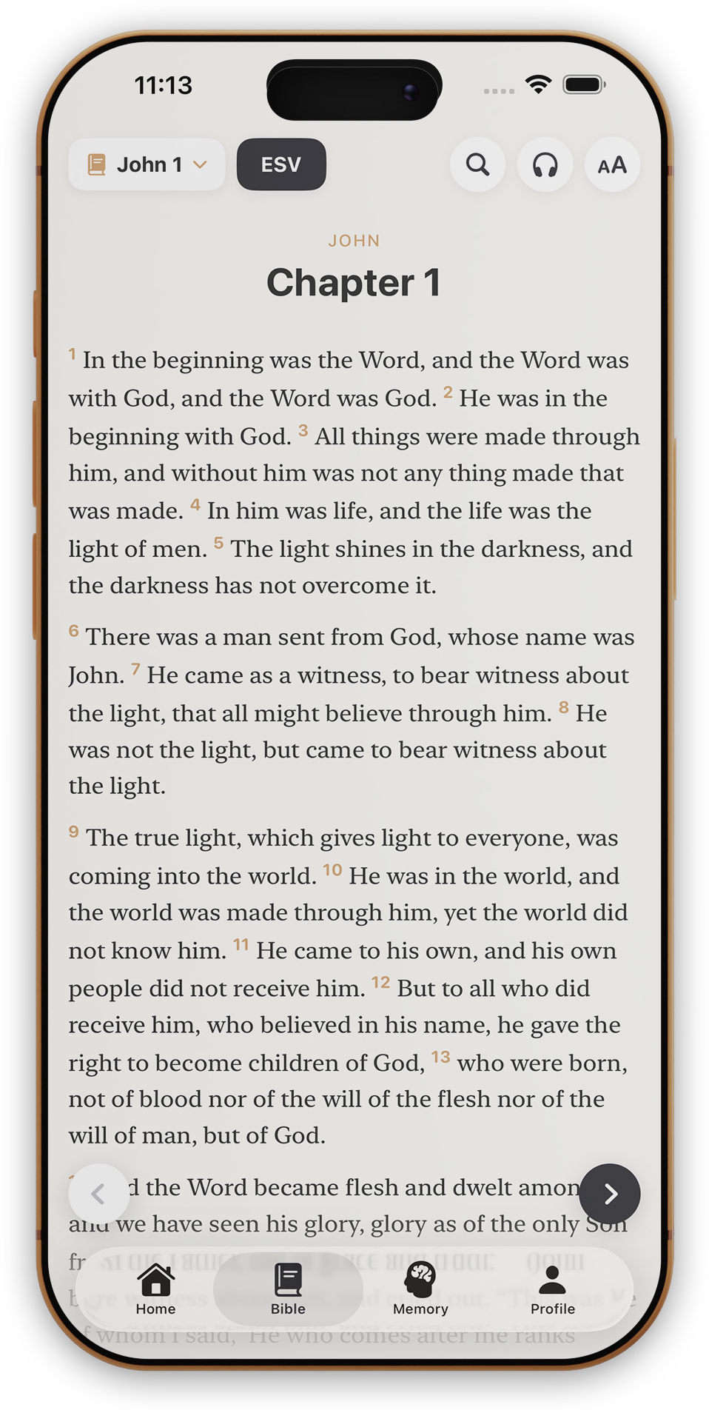
What Reforged actually is
1
2
3
Read
Memorize
Build the habit
Five translations, clean and ad-free. Tap any word for the original Hebrew or Greek.
Spaced repetition — the same method language apps use — so verses move into long-term memory.
Reading streaks and gentle daily nudges, pointed at something eternal instead of a gym ring.
Notes:
What Reforged actually is. Script section 4 (3:15-5:00).

Slide 5
What changed for me
Not
discipline.
It comes
back to me.
Hidden in
my heart.
It’s the path of least resistance now — the notification I already trust.
Verses I’ve memorized surface in traffic, in hard conversations, at 2am.
Scripture only read gets forgotten by Tuesday. Scripture memorized is there when I need it.
Notes:
How it's changed my everyday life. Script section 5 (5:00-6:00). Drop in your specific verse/moment here when speaking.

Slide 6
This isn’t really
about an app.
God’s Word was never meant to be something we visit when we feel spiritual enough.
It was meant to be daily bread — ordinary, built into the rhythm of a life.
Notes:
The bigger point. Script section 6 (6:00-7:00).

Slide 7
PSALM 119:105
“Your word is a lamp to my feet
and a light to my path.”
Pick one small, honest way to be in God’s Word tomorrow morning.
Something so small you can’t talk yourself out of it.
Notes:
Close — the challenge. Script section 7 (7:00-8:00).

Slide 8

Thank you.
Reforged — Bible Study & Memory · Free, ad-free, reader-supported
Free on the App Store · reforgedapp.org
Notes:
Thank you / close.

